Slide 1
F3.Bootstrap
ICT-Training Technical Skills

Slide 2
Bootstrap Registration Coding's
<html>
<head>
<title>Boostrap Form</title>
<link rel="stylesheet" type="text/css" href="bootstrap.min.css">
</head>
<body>
<form name="Registration" action=" " method=" ">
<div class="container-fluid mt-3 input-group-lg">
<div class="row">
<div class="col-md-12" style=text-align:center><h2>Students Registration</h2></div><br>
</div><br>

Slide 3
Bootstrap Registration Coding's
<div class="row">
<div class="col-md-6" style=text-align:right>Name:</div>
<div class="col-md-3"><input type="name" name="stud_name" class="form-control" value=""></div>
</div><br>
<div class="row">
<div class="col-md-6" style=text-align:right>DOB:</div>
<div class="col-md-3"><input type="date" name="stud_name" class="form-control" value=""></div>
</div><br>
<div class="row">
<div class="col-md-6" style=text-align:right>Gender:</div>
<div class="col-md-3"><input type="radio" name="stud_gender" value="male">Male
<input type="radio" name="stud_gender" class="form-label" value="female">Female</div>
</div><br>

Slide 4
Bootstrap Registration Coding's
<div class="row">
<div class="col-md-6" style=text-align:right>Qualification:</div>
<div class="col-md-3"><input type="checkbox" name="stud_qualification" class="form-check-input" value="HTML">HTML
<input type="checkbox" name="stud_qualification" class="form-check-input" value="CSS">CSS
<input type="checkbox" name="stud_qualification" class="form-check-input" value="JS">JS
<input type="checkbox" name="stud_qualification" class="form-check-input" value="PHP">PHP
<input type="checkbox" name="stud_qualification" class="form-check-input" value="MySQL">MySQL</div>
</div><br>

Slide 5
Bootstrap Registration Coding's
<div class="row">
<div class="col-md-6" style=text-align:right>Address:</div>
<div class="col-md-3"><textarea rows="3" cols="15" name="student_name" class="form-control"></textarea></div><br>
</div><br>
<div class="row“>
<div style="text-align : center">
<input type="button" class="btn btn-primary" name="stud_registration" value="Register"></div>
</div></div>
</form>
</body>
</html>

Slide 6
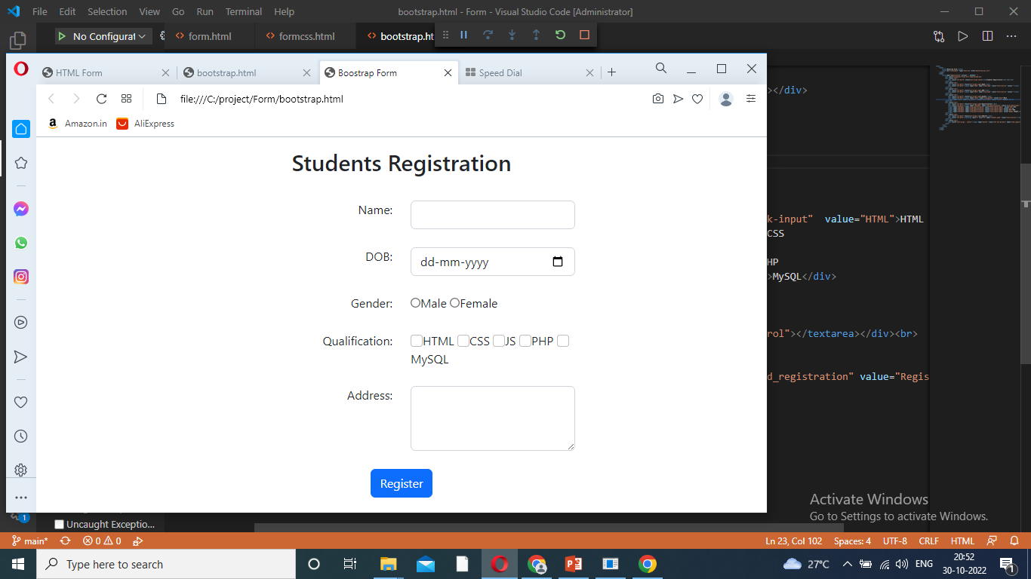
Display Registration Form

